Slide 1
Modern Application and API development
Module – 01
Class-06
CSS-05
Saylani Mass IT Training Faisalabad

Slide 2
CSS Flexbox
The flexbox or flexible box model in CSS is a one-dimensional layout model
IT has flexible and efficient layouts with distributed spaces among items to control their alignment structure
ie., it is a layout model that provides an easy and clean way to arrange items within a container.
Flexbox can be useful for creating small-scales layouts & is responsive and mobile-friendly.
Flex Container
Flex Items
Flex Direction

Slide 3
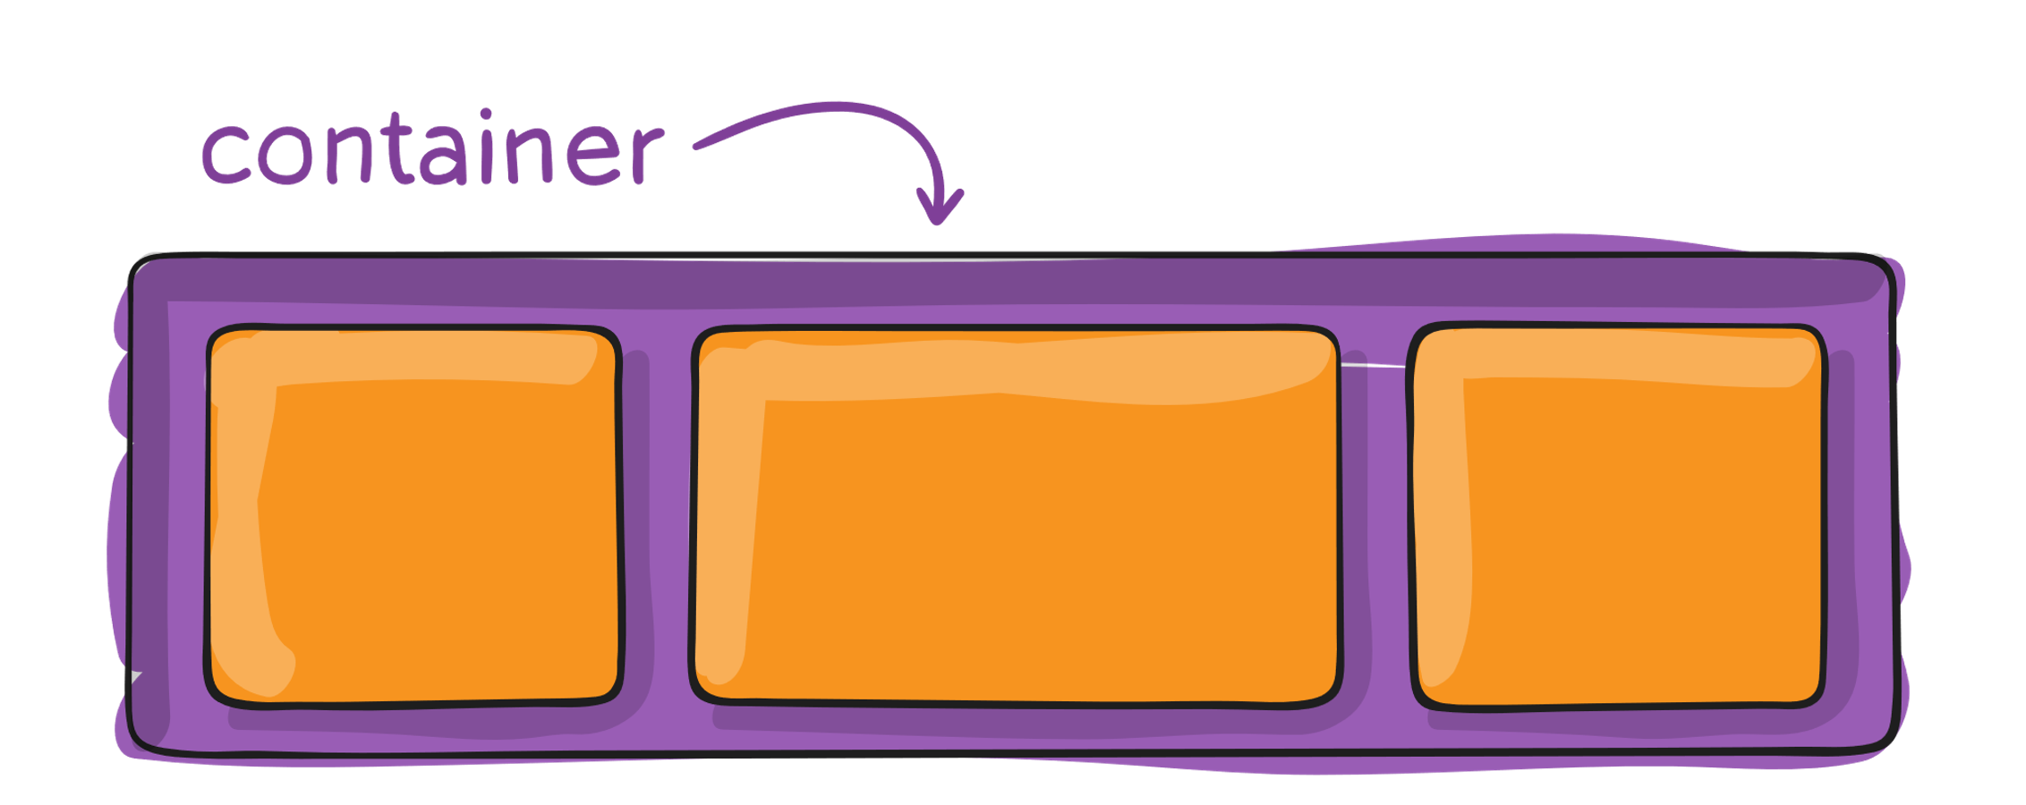
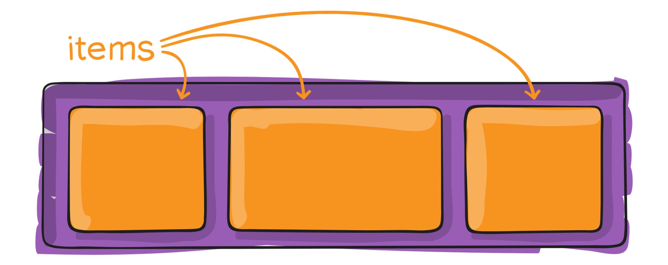
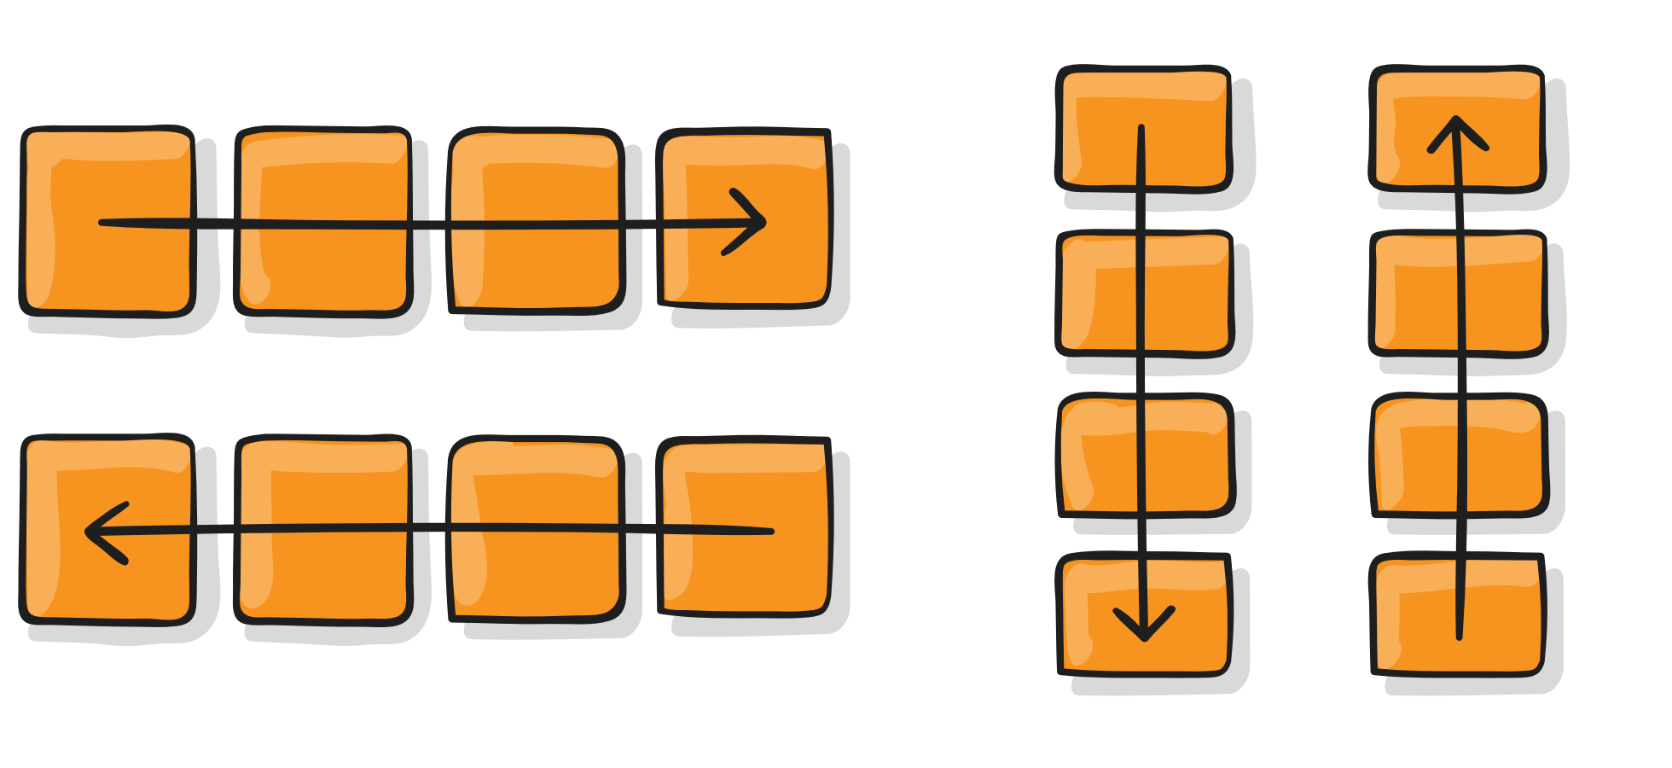
CSS Flex-Box

Slide 4
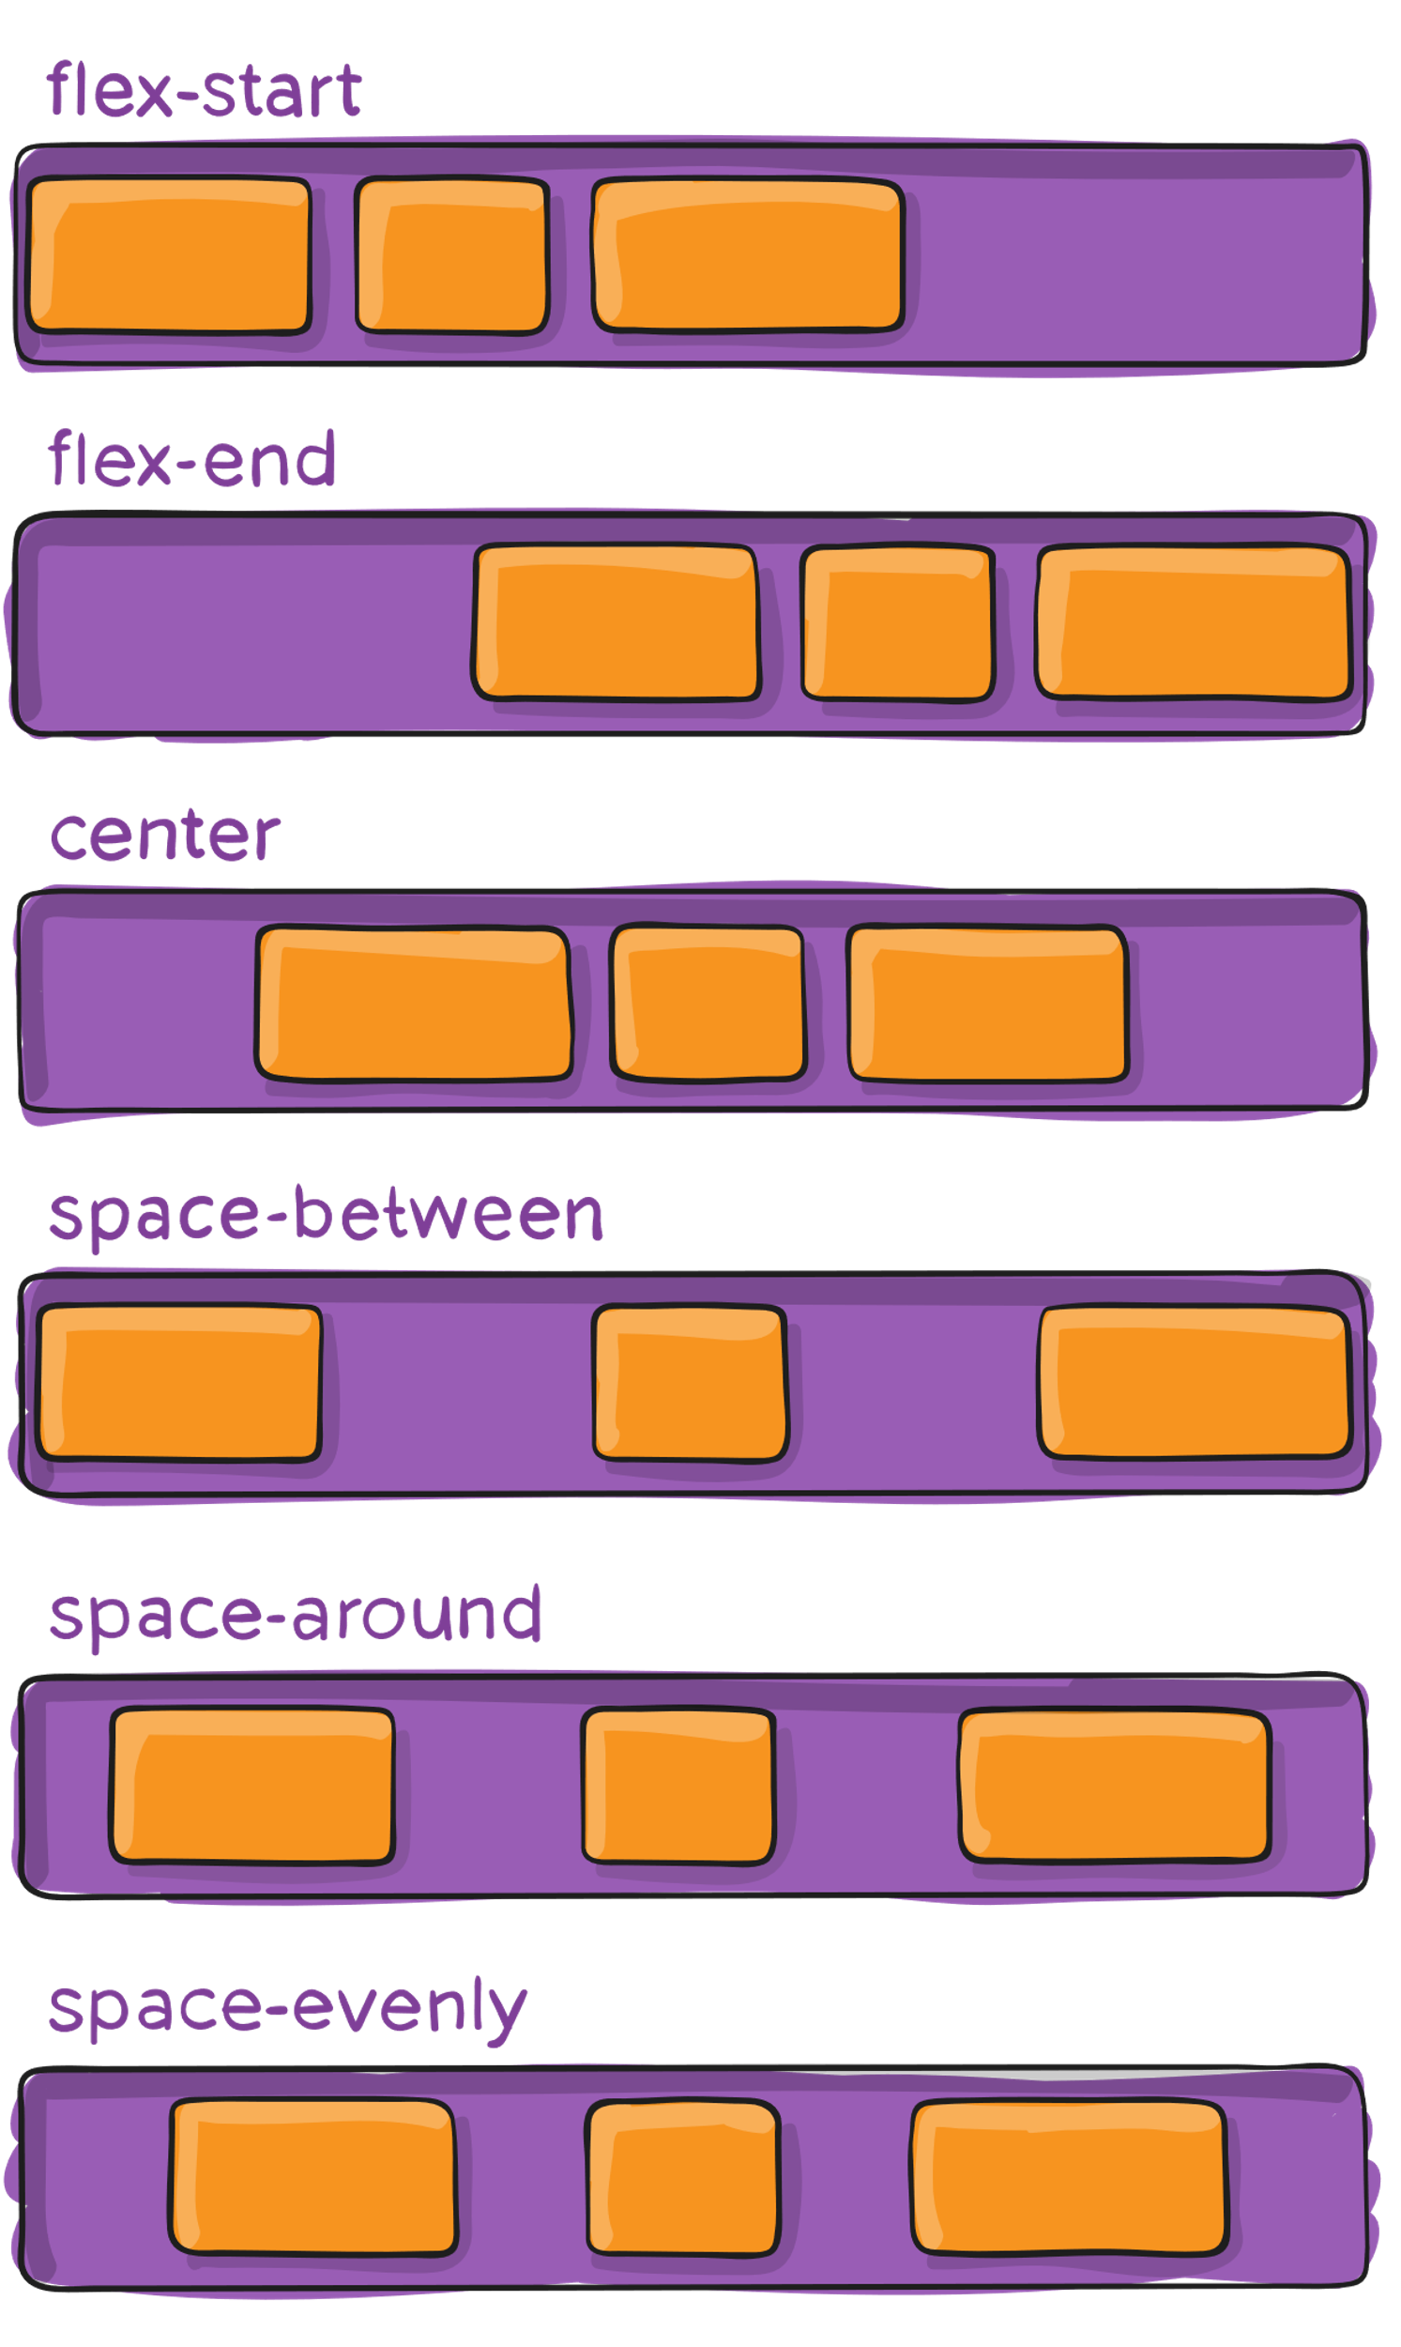
Justify-Content

Slide 5
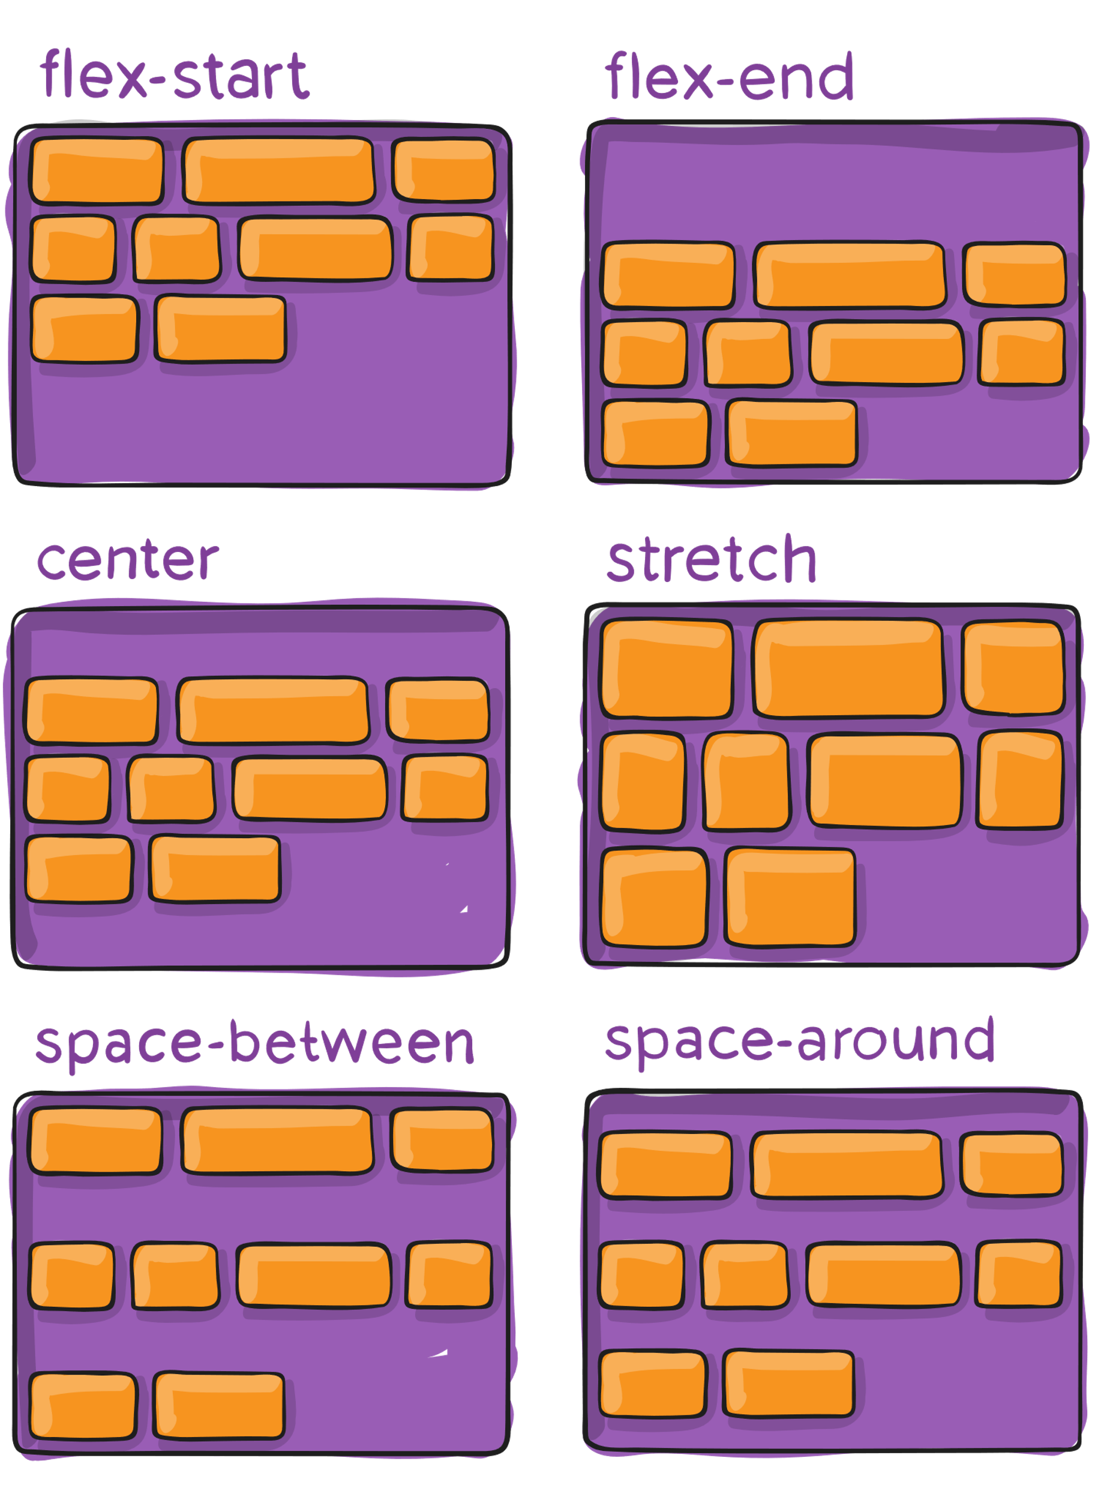

Slide 6
Flex Container
Flex Direction (row reverse , column reverse)
Justify content (center , flex-end , flex-start)
Align-item {vertically} (center , flex-end , flex-start)
Justify-content (space-between , space-around)
Flex-wrap (wrap , wrap-reverse)
Flex-flow (shorthand property) (wrap , column)

Slide 7
Flex Item
Flex grow (number)
Flex-shrink ()
Order (number)
Align-self (center)
Flex-Box Froggy

Slide 8
Media Quries
@media (min-width:0px) and (max-width:414px) {
}

